Slide 1
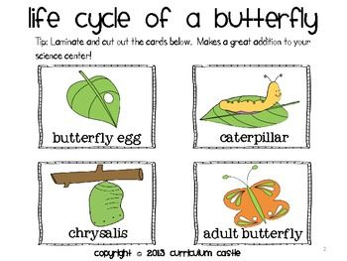

Slide 2

Butterfly Life Cycle

Slide 3
Butterfly Life Cycle
A butterfly lays an egg.
After a period, the caterpillar emerges as an adult butterfly.
The egg hatches with a caterpillar. They begin to eat.
After the caterpillar eats, he forms a cocoon. This is the chrysalis stage.

