Slide 1
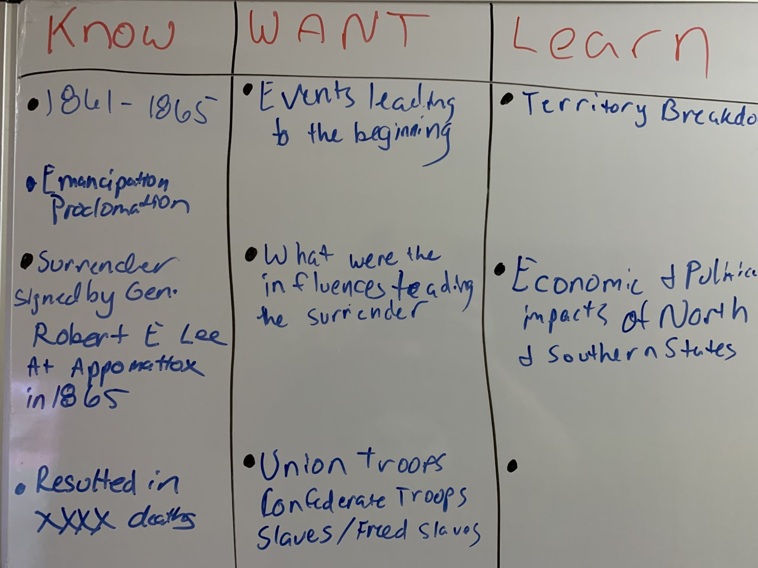
KWL Example
What Do I Know?
What Do I Want To Know
What Have I Learned?

Slide 2
